Slide 1
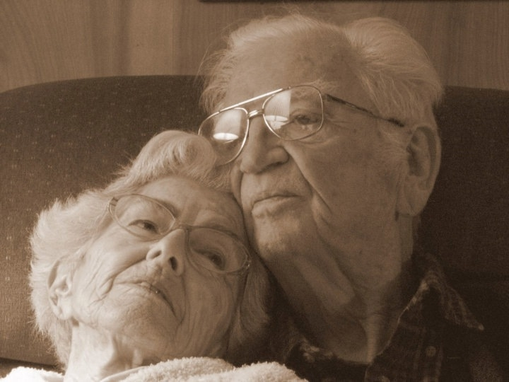

Elder Wellness Program focused on Delirium Prevention
When older adults are hospitalized, their daily routines are disrupted. They can lose their bearings and become mentally confused and disoriented (called delirium).

Slide 2
In multiple studies the Hospital Elder Life Program , which Elder Wellness is modeled after, demonstrated effective prevention of delirium and other adverse outcomes of hospitalization:
Delirium prevention and quality improvement (Zaubler 2013)
Prevention of delirium (Rubin 2011, Chen 2011, Caplan 2007, Rubin 2006, Inouye 1999)
Prevention of functional decline (Inouye 2000)
Prevention of cognitive decline (Inouye, 2000)
Decreased hospital length of stay (Rubin 2011, Caplan 2007, Rubin 2006)
Reduced nursing home placement (Caplan 2007)
Decreased rate of hospital falls (Inouye 2009, Caplan 2007)

Slide 3
Development & Implementation
Recruit volunteers
  Students (Pre-Med, Nursing, Gap year, PA, PT/OT)
  Retired RNs , Social Workers
  People with experience caring for elder family members
Training & Development
  Healthstream training for RN’s and CNA/SNA
  Volunteer Training
  CAM (Confusion Assessment Method) created in Meditech

Slide 4
Assessment, Referral & Intervention
CAM assessment every shift by nursing
Elder Wellness Specialist screens eligible patients using Mini Mental Status
Determines a specific plan for each patient and creates a referral for Elder Wellness Volunteers
The Elder Wellness Volunteers provide:
Daily visits: to promote socialization and orientation
Mobility: leading range of motion exercises
Meal Time Assist
Therapeutic Activities

Slide 5

Overall Goals
Early Recognition
  Maintaining Cognitive/Physical Functioning
Early Treatment of Underlying Causes
Focus on Prevention
  Maximize Independence at Discharge

Slide 6
Next Steps
Refine electronic assessment tool
Continue to add and develop EWP Toolkit
MD order set
Develop measurement tool to assess pre & post intervention
Contact Information
Elaine Willey - Director of Volunteer Services Milford Regional Medical Center
ewilley@milreg.org
508-422-2263

